Slide 1
SAA Preservation Section Meeting
August 9, 2012
Room Saphire MN
3:30 – 3:55 Welcome from Chair
Committee Reports
Election Results
Jennifer Waxman, Preservation Section Chair
3:55 – 4:00 Announcements
Announcements from Members
Positions Available
4:00 – 5:30 Preservation in the 21st Century Discussion Panel
        Archivists and preservation specialists will share perspectives on the
        future of the profession including preservation education and
        research, evolving professional responsibilities, mapping digital
        preservation to traditional activities, and building partnerships with
        allied professionals (conservators, technologists, manufacturers).

Slide 2
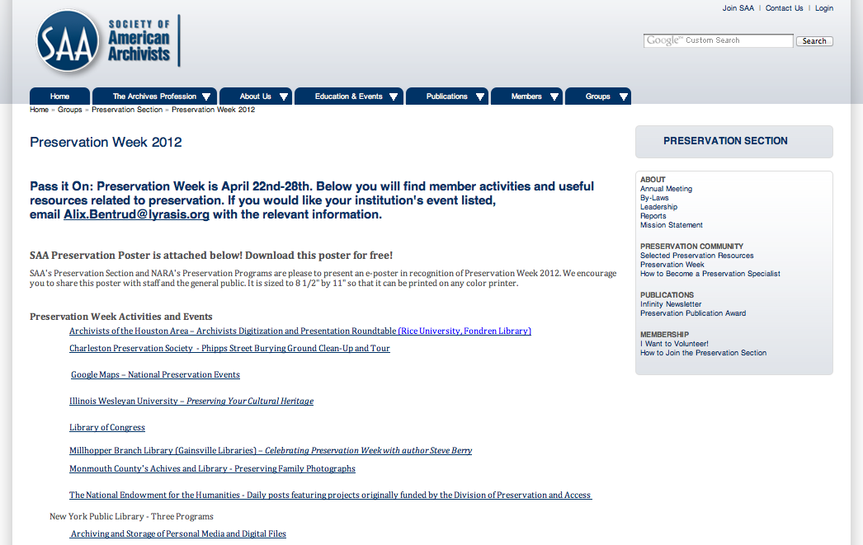
Preservation Week
Pres Week Screen shot

Slide 3
Preservation Week

Slide 4
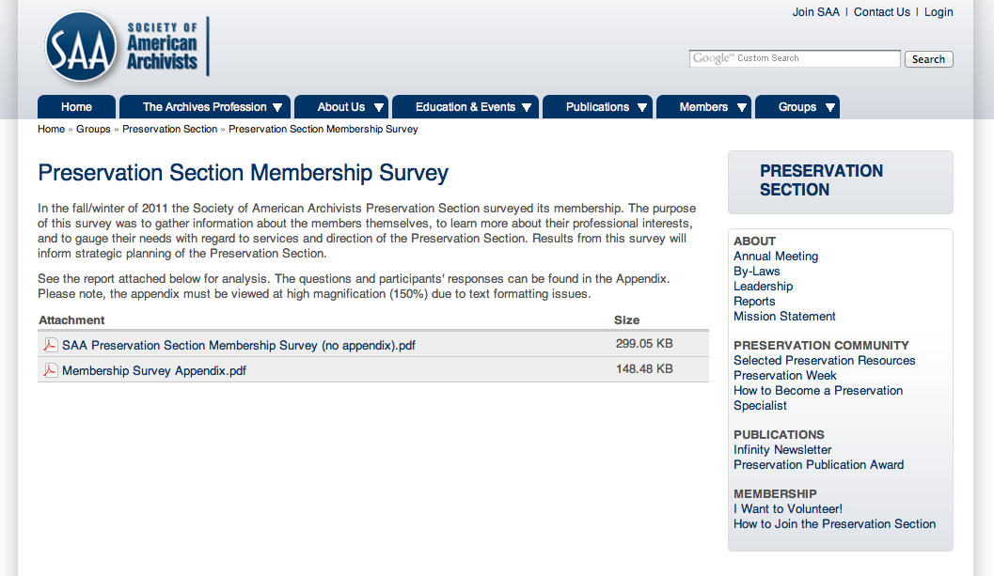
Membership Survey
Pres Survey screenshot

Slide 5
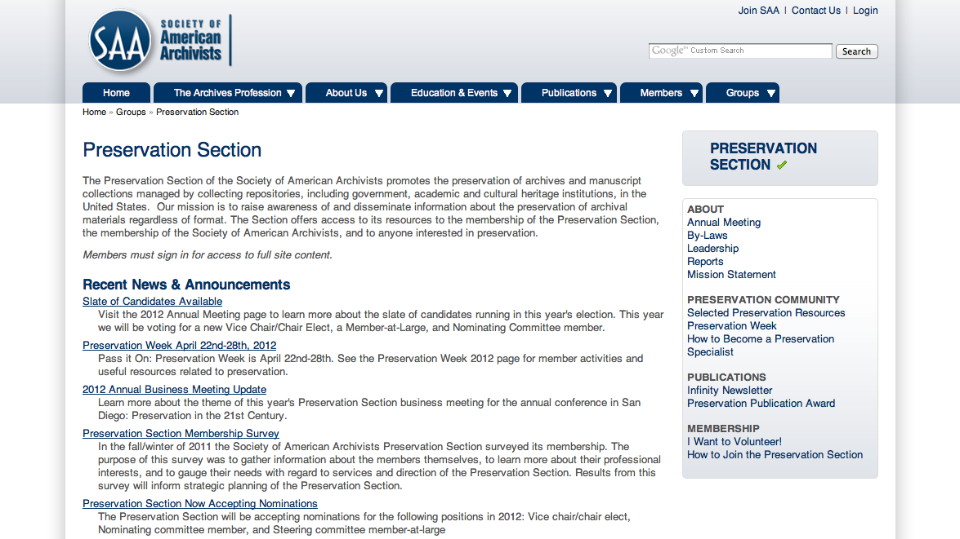
Section Website
http://www2.archivists.org/groups/preservation-section

Slide 6
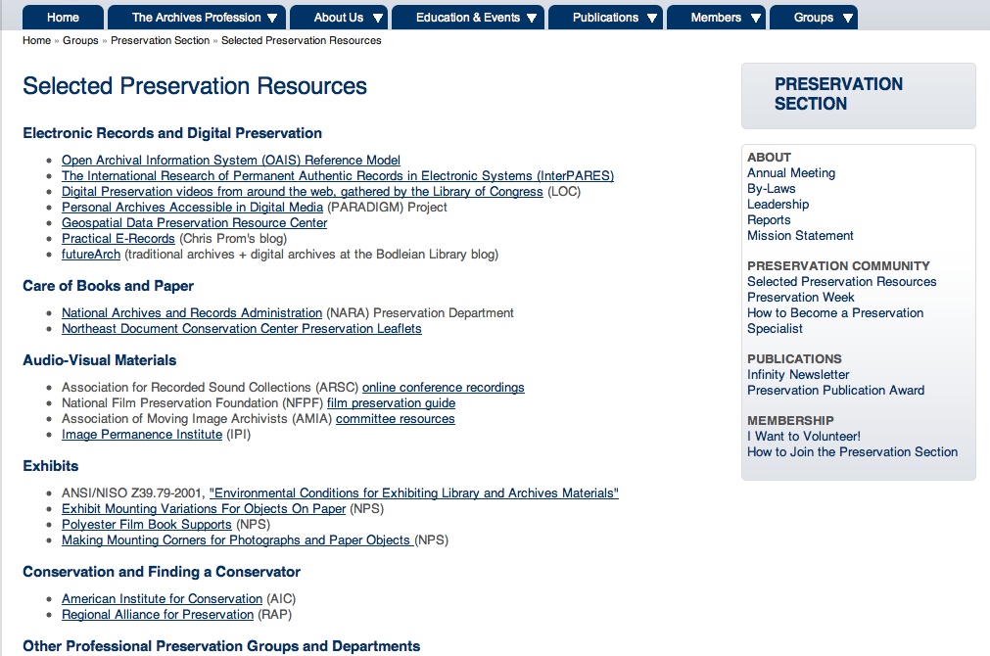
Selected Preservation Resources
Resources page screenshot

Slide 7
Preservation in the 21st Century
Archivists and preservation specialists will share perspectives on the future of the profession including preservation education and research, evolving professional responsibilities, mapping digital preservation to traditional activities, and building partnerships with allied professionals (conservators, technologists, manufacturers).
Speakers:
Michele Cloonan, Dean, GSLIS, Simmons College
“The Pedagogy of Preservation”
Ann Marie Willer, Preservation Librarian, MIT
“Other Duties as Assigned: The Evolving Responsibilities of Preservation Administrators”
Ian Bogus, MacDonald Curator of Preservation, University of Pennsylvania Libraries
"Digital Preservation: It's More Familiar Than You Think!”
Karen Gracey, Professor, SLIS, Kent State University
“Preservation Education: A Research Agenda for the Next Decade and Beyond”

